Slide 1





SCHOOL OF ENGINEERING
Probability and Statistics
A.Y. 2024-25
Freshmen Engineering Department

Slide 2

Importance of the course
➡️ Why do you think mathematics is important in engineering?
Mathematics
Engineering fields
Designing Circuits
Analysing Signals
Studying Mechanical Vibrations

Slide 3

Importance of the Course
Probability and statistics are important in engineering because they help us understand and manage uncertainty in real situations.
Many things in engineering — like loads, signals, failures, or delays — are unpredictable, and probability helps measure these risks.
Statistics helps engineers make better decisions by using data to design systems that are safer, stronger, and more efficient.
These concepts are used everywhere in engineering, such as quality control in factories, reliability of machines, communication system performance, machine learning, traffic and network analysis, and project planning.
Real-Life Example : Mobile Network Signal Strength
When you move, your mobile signal becomes strong or weak unexpectedly.
Engineers collect signal data, analyze it statistically, and calculate the probability of call drops or errors.
Using this, they design better towers and improve network coverage.
1

Slide 4
Course Outcomes
Course Outcomes: At the end of the Course, Student will be able to:
CO1: | Apply Baye’s theorem
CO2: | Apply various Probability distributions for both discrete and continuous random variables
CO3: | Compute mean and variance of sample means with replacement and without replacement and maximum errors.
CO4: | Apply various tests to test the hypothesis concerning mean, Proportion, variance and attributes.
CO5: | Apply the concepts of correlation and regression to the given statistical data.
1

Slide 5

Syllabus
UNIT – I: Probability and Random Variables:
Probability – Conditional probability and Baye’s Theorem
Random variables – Discrete and Continuous random variables
Mathematical Expectation, Variance and
Moment generating function.
Practice(Using any computational tool):
Calculation of Mean and Variance
UNIT – II: Probability Distributions:
Distribution function
Binomial, Poisson, Normal and Exponential distributions.
Practice(Using any computational tool):
Discrete and continuous probability distributions (Binomial, Poisson, normal and exponential distributions)
1

Slide 6
Syllabus
UNIT – III: Data Analytics and Sampling Theory
Data Analytics:
Data science –Collection of data – primary and secondary data
Types of variables: dependent and independent Categorical and Continuous variables
Data visualisation
Measures of Central tendency(Mean, mode and median)
Measures of Variability (spread or variance).
Sampling Theory:
Introduction – Population and samples
Sampling distribution of Means and Variance
Central limit theorem (without proof)
Point and Interval estimations
Maximum error of estimate.
Practice(Using any computational tool):
1. Finding measures of variability and central tendency (mean, median, mode, arithmetic mean, geometric mean, Variance)
2. Data visualisation (Construction of bar charts, pie charts).
3. Construction of confidence intervals
1

Slide 7
Syllabus
UNIT – IV: Tests of Hypothesis
Introduction – Hypothesis
Null and Alternative Hypothesis
Type I and Type II errors
Level of significance
One tail and two-tail tests
Tests concerning one mean and two means (Large and Small samples)
Tests on proportions, Chi-Square and F test.
Practice(Using any computational tool):
1. Z-test, t-test and Chi-square test
1

Slide 8
Syllabus
UNIT – V: Correlation and Regression
Method of least squares
Straight line - nonlinear curves– parabola -Exponential – Power curves
Correlation – Karl Pearson’s correlation coefficient – rank correlation
regression-– regression coefficients and properties (without proof) –regression lines
Practice(Using any computational tool):
1. Finding the correlation coefficient and regression lines
1

Slide 9

Books
Text Books:
Reference Books:
1 | Miller and Freund’s, Probability and Statistics for Engineers, 9/e, Pearson, 2020.ISBN978-9353945237
2 | Fundamentals of Mathematical Statistics, S.C. Gupta and V.K.Kapoor, 12th edition, Sultan Chand & Sons Publications, 2020.ISBN 978-9351611738
1 | Probability, Statistics and Random processes, T.Veerrajan, Tata McGraw-Hill.ISBN 978-0070669253
2 | Probability and statistics by T.K.V. Iyengar, S. Chand publishers,2022 ISBN 9789355010643
3 | Modern Statistics: Intuition, Math, Python, R by Mike X Cohen.ISBN 9798867723736
1

Slide 10

Web Links
Web Links:
1. https://onlinecourses.nptel.ac.in/noc21_ma74/preview
2. http://mathworld.wolfram.com/topics/ProbabilityandStatistics.html
3. https://www.khanacademy.org/math/statistics-probability
4. https://www.geeksforgeeks.org/statistics-with-python/
5. https://www.coursera.org/learn/inferential-statistical-analysis-python?specialization=statistics-with- python
1

Slide 11
Introduction
1. What is Probability?
Probability measures how likely an event is to happen., The probability value is always between 0 and 1.
0 → impossible event
1 → certain event
Between 0 and 1 → possible event
Example:
Probability of getting a number when you roll a die = 1 (certain event).
Probability of getting a 9 when rolling a standard die = 0 (impossible event).
1

Slide 12
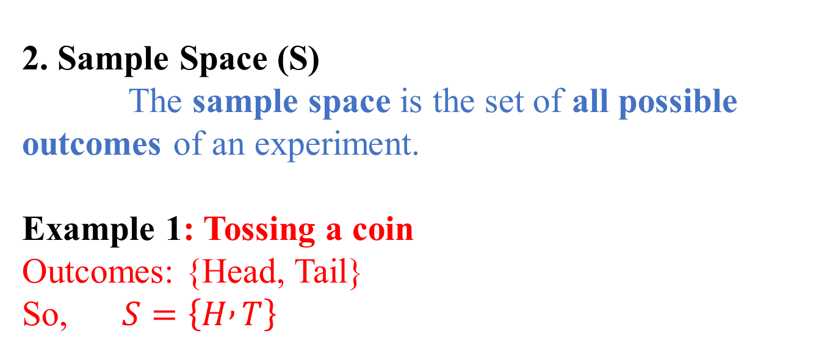
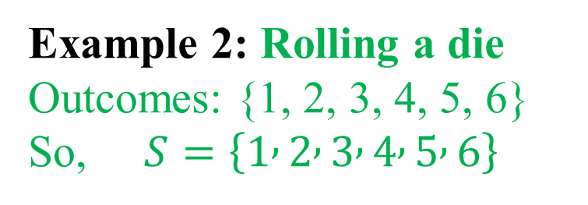
Introduction
2. Sample Space (S)
The sample space is the set of all possible outcomes of an experiment.
Example 1: Tossing a coin
Outcomes: {Head, Tail} So, $S=\left\{H , T\right\}$
Example 2: Rolling a die
Outcomes: {1, 2, 3, 4, 5, 6} So, $S=\left\{1 , 2 , 3 , 4 , 5 , 6\right\}$
1

Slide 13
Introduction
3. Event (A)
An event is a subset of the sample space — one or more outcomes you are interested in.
Example 1: Rolling an even number
Event A = {2, 4, 6}
Example 2: Getting a Head when tossing a coin
Event A = {H}
1

Slide 14
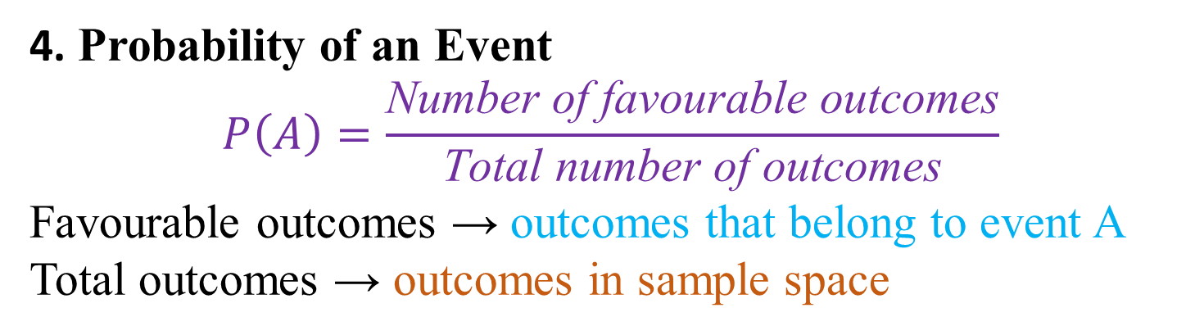
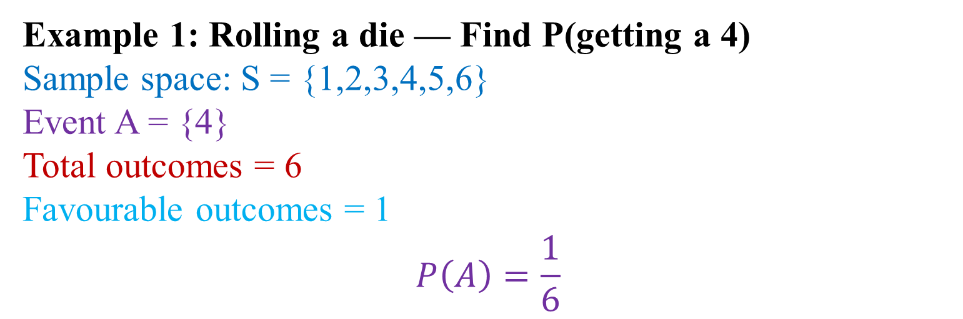
Introduction
4. Probability of an Event
$$P\left(A\right)=\frac{\text{Number} \text{of} \text{favourable} \text{outcomes}}{\text{Total} \text{number} \text{of} \text{outcomes}}$$
Favourable outcomes → outcomes that belong to event A
Total outcomes → outcomes in sample space
Example 1: Rolling a die — Find P(getting a 4)
Sample space: S = {1,2,3,4,5,6}
Event A = {4} Total outcomes = 6 Favourable outcomes = 1
$$P\left(A\right)=\frac{1}{6}$$
1

Slide 15
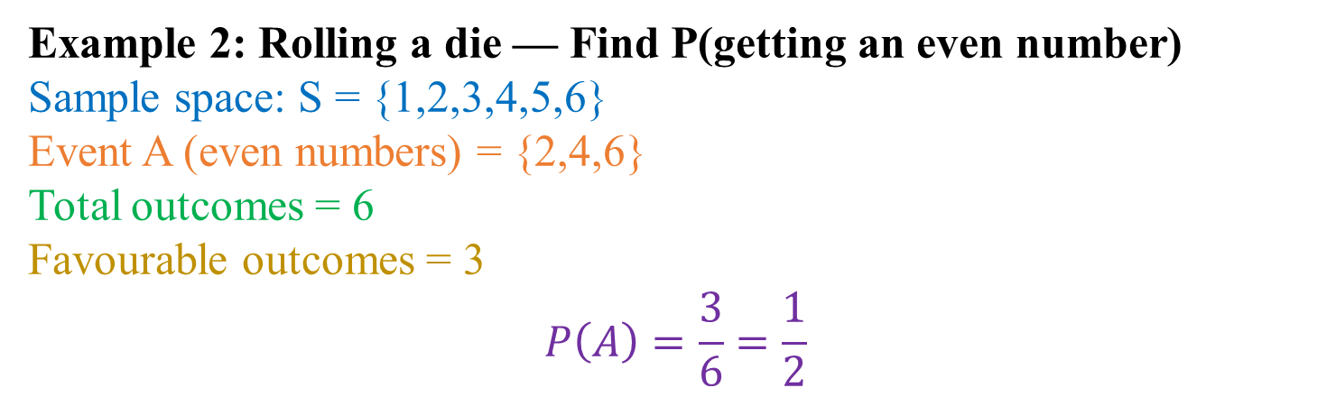
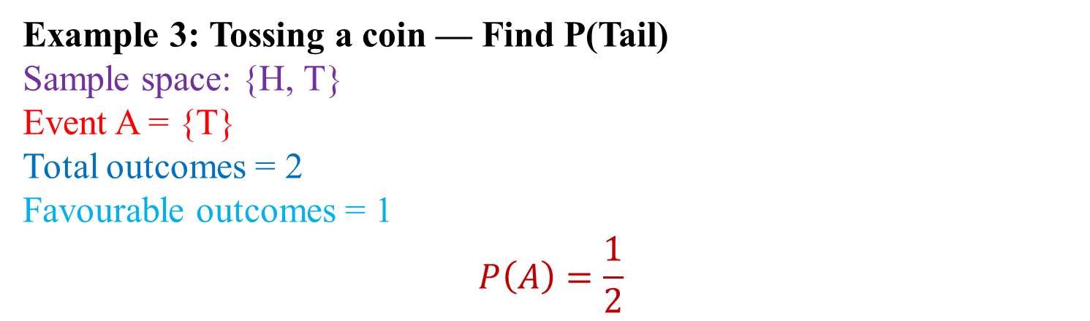
Introduction
Example 2: Rolling a die — Find P(getting an even number)
Sample space: S = {1,2,3,4,5,6} Event A (even numbers) = {2,4,6}
Total outcomes = 6 Favourable outcomes = 3
$$P\left(A\right)=\frac{3}{6}=\frac{1}{2}$$
Example 3: Tossing a coin — Find P(Tail)
Sample space: {H, T} Event A = {T}
Total outcomes = 2 Favourable outcomes = 1
$$P\left(A\right)=\frac{1}{2}$$
1

Slide 16
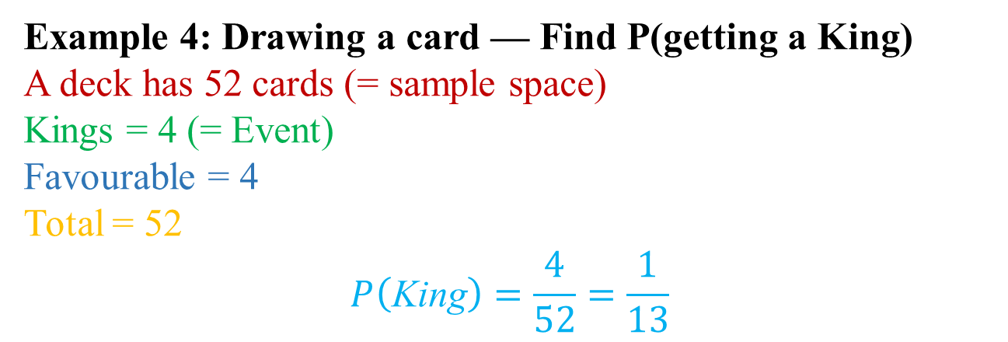
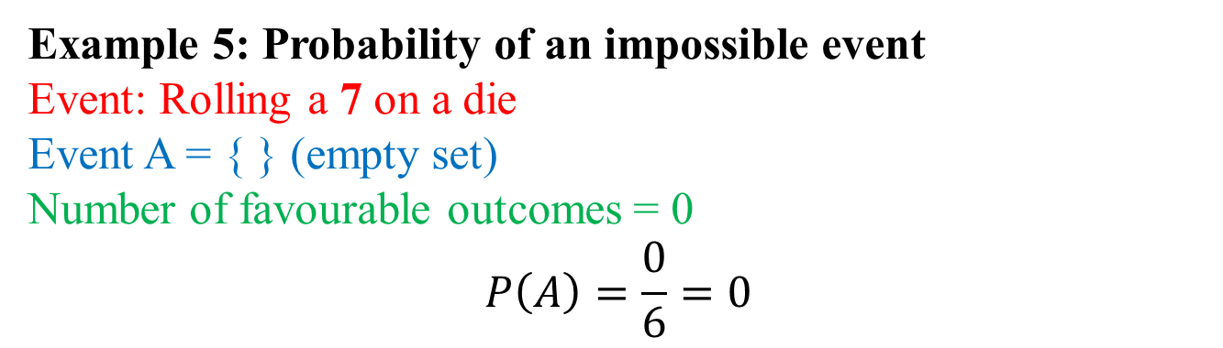
Introduction
Example 4: Drawing a card — Find P(getting a King)
A deck has 52 cards (= sample space) Kings = 4 (= Event)
Favourable = 4 Total = 52
$$P\left(\text{King}\right)=\frac{4}{52}=\frac{1}{13}$$
Example 5: Probability of an impossible event
Event: Rolling a 7 on a die Event A = { } (empty set) Number of favourable outcomes = 0
$$P\left(A\right)=\frac{0}{6}=0$$
1

Slide 17
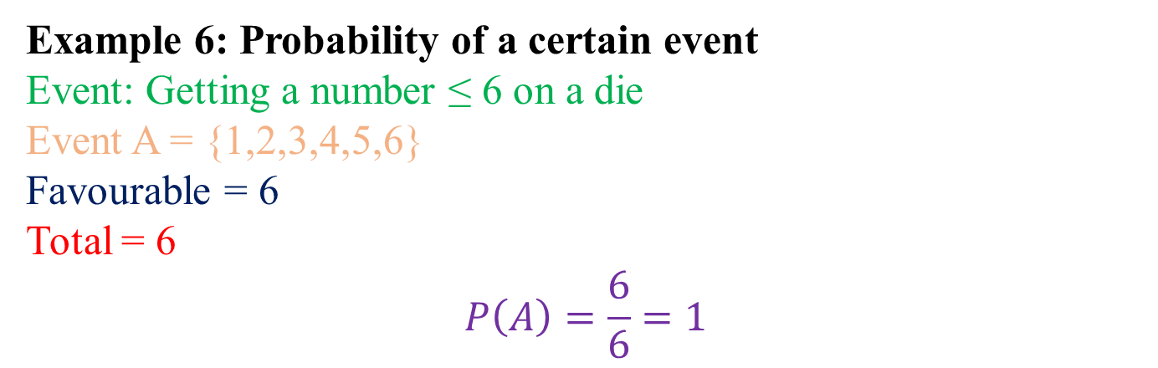

Introduction
Example 6: Probability of a certain event
Event: Getting a number ≤ 6 on a die Event A = {1,2,3,4,5,6}
Favourable = 6 Total = 6
$$P\left(A\right)=\frac{6}{6}=1$$
Note:
Sample space (S): all possible results
Event (A): specific result(s) we want
Probability:
$$P\left(A\right)=\frac{\text{favourable} \text{outcomes}}{\text{total} \text{outcomes}}$$
1

Slide 18
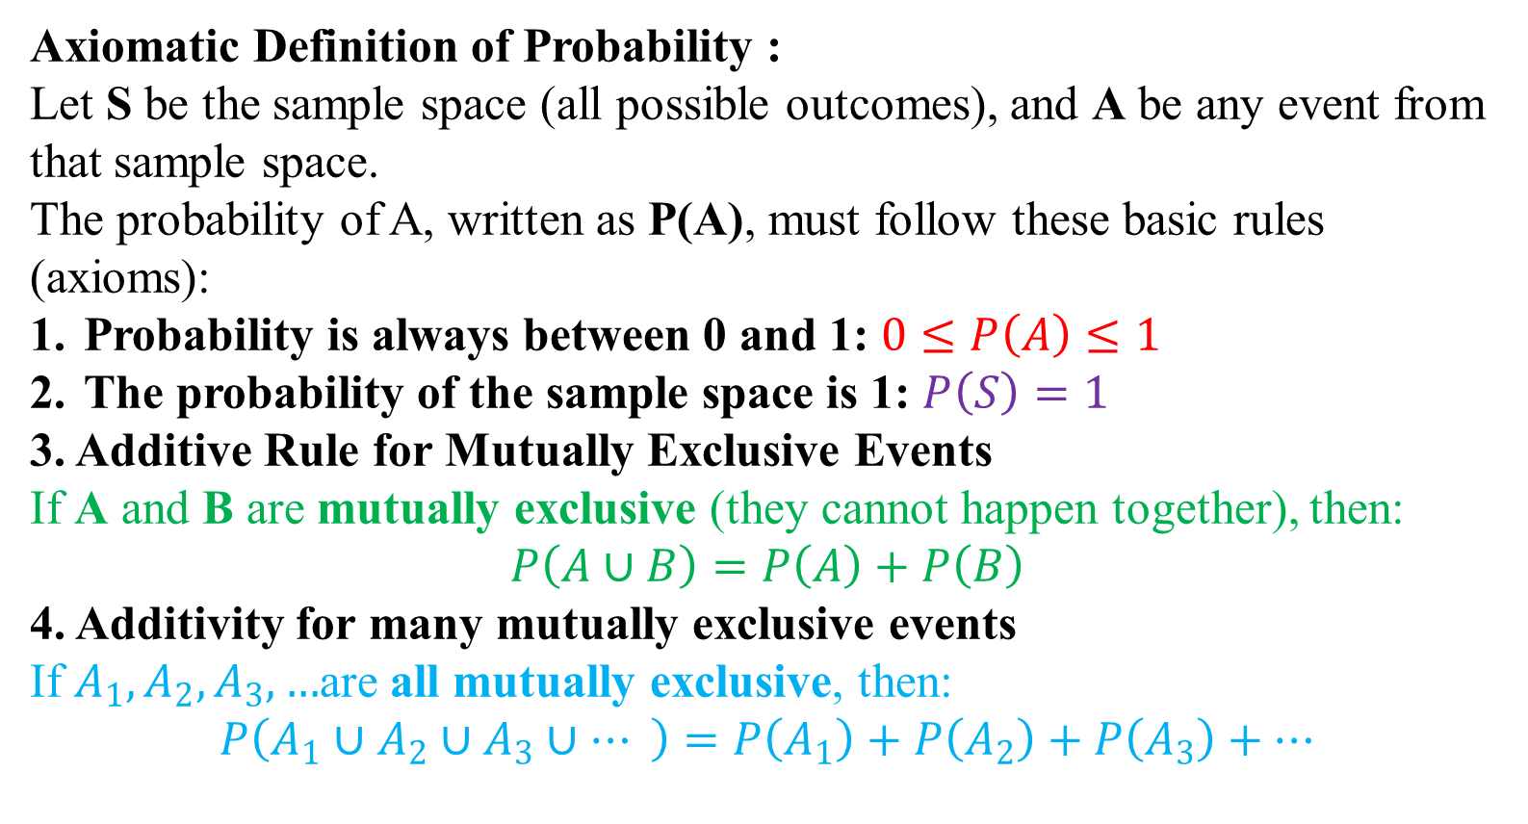
Axiomatic Definition of Probability
Axiomatic Definition of Probability :
Let S be the sample space (all possible outcomes), and A be any event from that sample space.
The probability of A, written as P(A), must follow these basic rules (axioms):
Probability is always between 0 and 1: $0≤P\left(A\right)≤1$
The probability of the sample space is 1: $P\left(S\right)=1$
3. Additive Rule for Mutually Exclusive Events
If A and B are mutually exclusive (they cannot happen together), then:
$$P\left(A∪B\right)=P\left(A\right)+P\left(B\right)$$
4. Additivity for many mutually exclusive events
If $A_{1},A_{2},A_{3},…$are all mutually exclusive, then:
$$P\left(A_{1}∪A_{2}∪A_{3}∪… \right)=P\left(A_{1}\right)+P\left(A_{2}\right)+P\left(A_{3}\right)+…$$
1

Slide 19
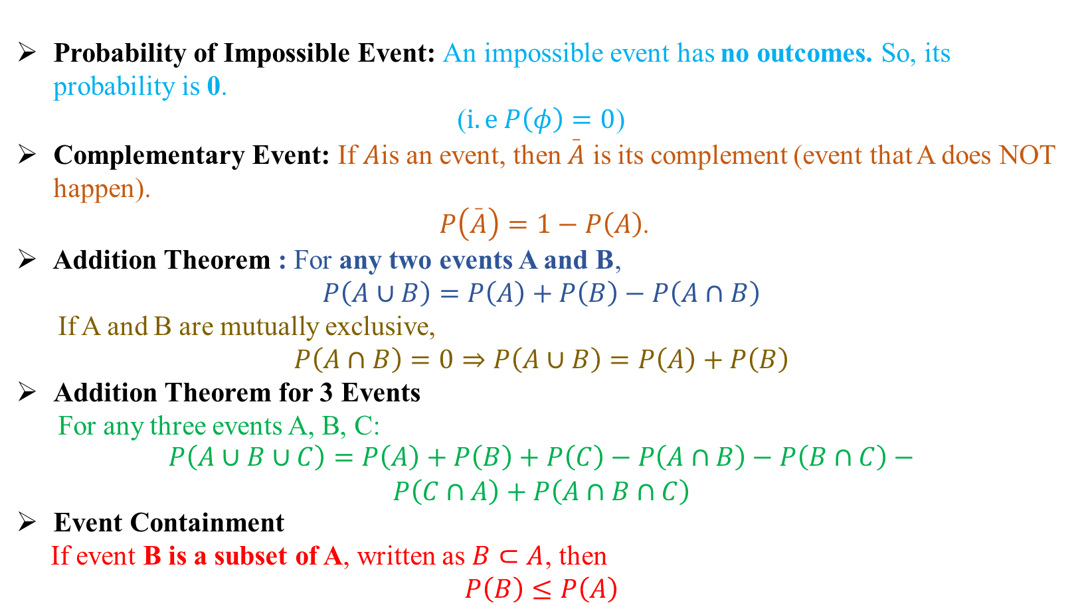
Note
Probability of Impossible Event: An impossible event has no outcomes. So, its probability is 0.
($i.e P\left(φ\right)=0$)
Complementary Event: If $A$is an event, then $\overset{_}{A}$ is its complement (event that A does NOT happen).
$P\left(\overset{_}{A}\right)=1−P\left(A\right)$.
Addition Theorem : For any two events A and B,
$$P\left(A∪B\right)=P\left(A\right)+P\left(B\right)−P\left(A∩B\right)$$
If A and B are mutually exclusive,
$$P\left(A∩B\right)=0⇒P\left(A∪B\right)=P\left(A\right)+P\left(B\right)$$
Addition Theorem for 3 Events
For any three events A, B, C:
$$\begin{aligned}P\left(A∪B∪C\right)=P\left(A\right)+P\left(B\right)+P\left(C\right)−P\left(A∩B\right)−P\left(B∩C\right)− \\ P\left(C∩A\right)+P\left(A∩B∩C\right)\end{aligned}$$
Event Containment
If event B is a subset of A, written as $B⊂A$, then
$$P\left(B\right)≤P\left(A\right)$$
1

Slide 20
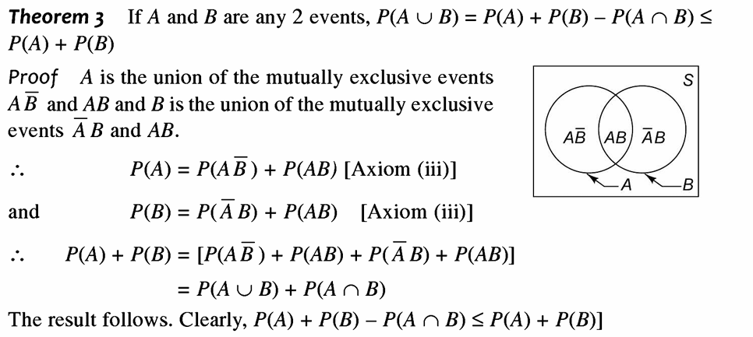
Addition Theorem
1

Slide 21
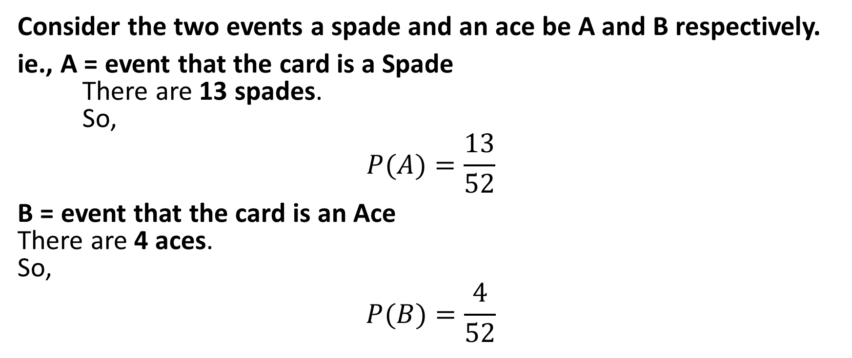
Addition Theorem
A card is drawn from a well-shuffled deck of 52 cards. Find the probability that it is either a spade or an ace.
Consider the two events a spade and an ace be A and B respectively.
ie., A = event that the card is a Spade There are 13 spades. So,
$$P(A)=\frac{13}{52}$$
B = event that the card is an Ace There are 4 aces. So,
$$P(B)=\frac{4}{52}$$

Slide 22
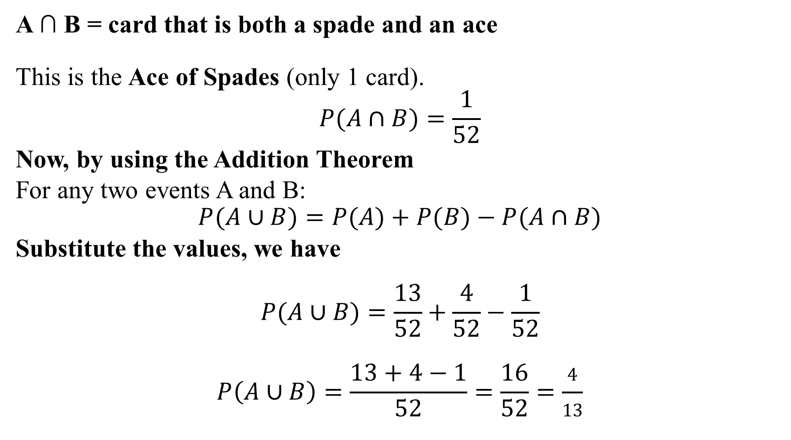
Addition Theorem
A ∩ B = card that is both a spade and an ace
This is the Ace of Spades (only 1 card).
$$P(A∩B)=\frac{1}{52}$$
Now, by using the Addition Theorem
For any two events A and B:
$$P(A∪B)=P(A)+P(B)−P(A∩B)$$
Substitute the values, we have
$$P(A∪B)=\frac{13}{52}+\frac{4}{52}−\frac{1}{52}$$
$$P\left(A∪B\right)=\frac{13+4−1}{52}=\frac{16}{52}=\frac{4}{13}$$

